Slide 1
Data Dive 3
Jacob Cuomo, Ryan Tran, Dylan Fox, and Colby Luttrell

Slide 2

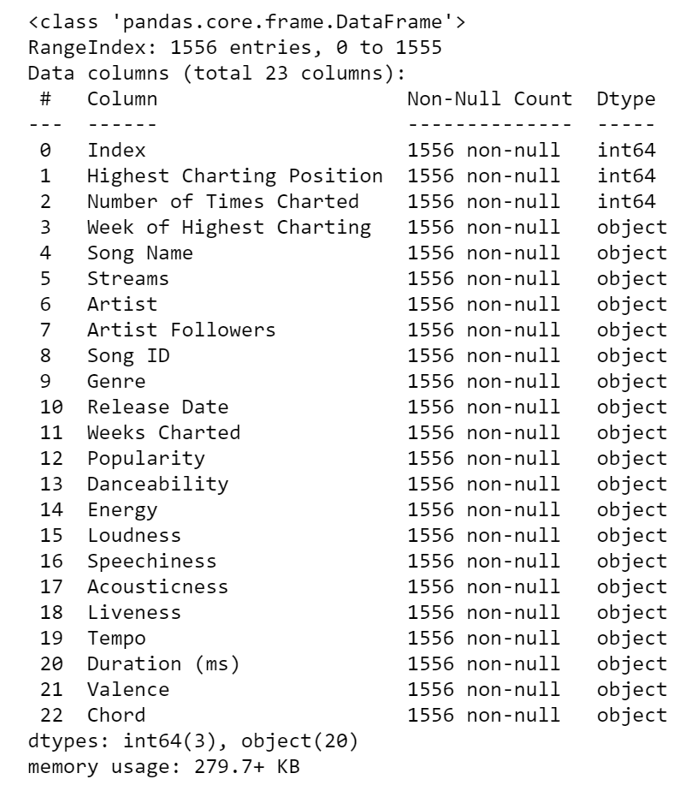
The Data: Top Spotify Songs
Most of the data were represented as objects, which made it hard to analyze at first.
After some data cleansing, we were able to interpret in any way we wished.
Attributes such as popularity, danceability, and energy are calculated by Spotify’s API.
What makes a song a top hit? Do chords and genre play a role? What songs and genres make the most money?

Slide 3
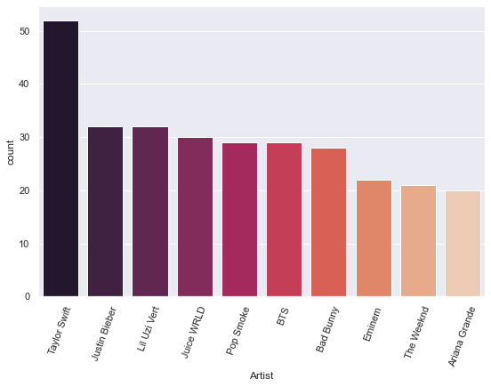
Does Being A Popular Artist Effect Song Popularity?
Data suggests that this is most likely the case with Taylor Swift, Justin Bieber, and Lil Uzi having the most songs in the top 200 song list dataset.
Most of these artists are well known by everybody and there are almost no artists that nobody would know about.

Slide 4

Artist vs Total Popularity
According to Spotify, “popularity is calculated by algorithm and is based, in the most part, on the total number of plays the track has had and how recent those plays are. Generally speaking, songs that are being played a lot now will have a higher popularity than songs that were played a lot in the past.”

Slide 5
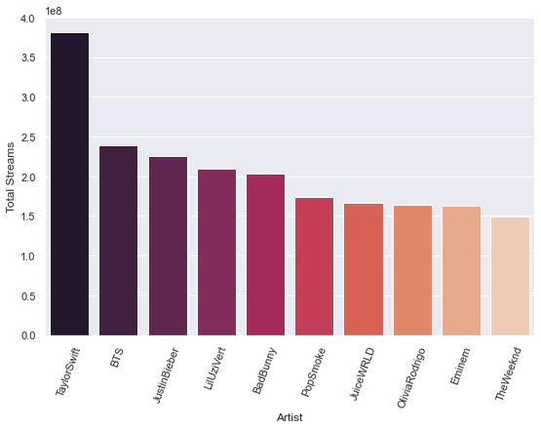
Artist vs Total Streams
Taylor Swift is frequently among the top on these graphs as she has had the most popular songs.
Keep in mind that the y-axis is in scientific notation, so 4.0 would really be 400,000,000 streams.
All these graphs have the same general flow with almost the same artists.

Slide 6
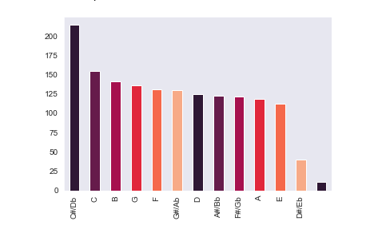
Most popular chord to write in
Songs written in the chord C#/Db chart far more often than any other chord.
C#/Db beats the second most popular chord by 30% or 59 appearances on the chart.
Would writing your song in C#/Db be more likely to get you a number one hit?

Slide 7
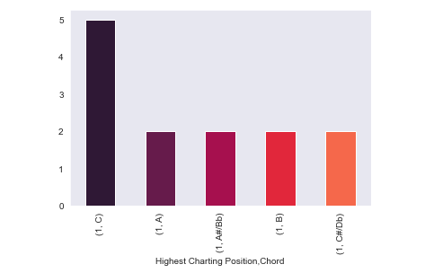
Chords popular with a number one hit
The Data overwhelming shows that if one were to want a number one song your best chances of getting there are to write it in the chord of C

Slide 8
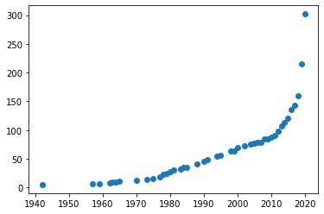
Growth in the Number of Genres over Time

Slide 9
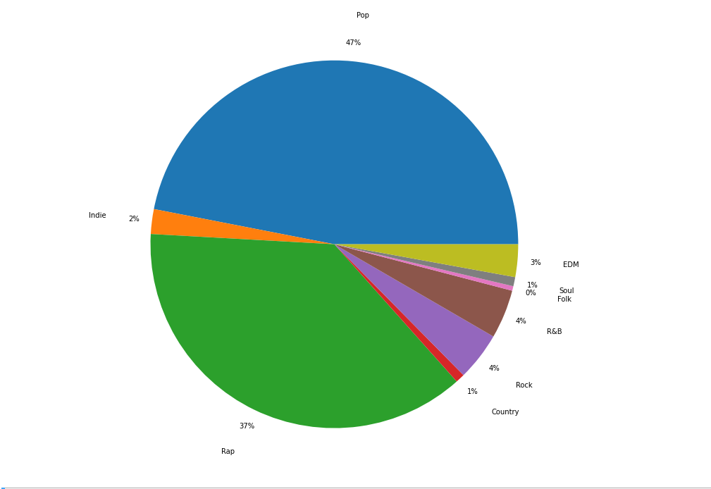
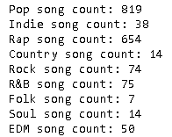
What genres are the most popular?
Songs may fall into more than one genre.
Pop and rap are commonly found in songs that charted on the Spotify top 200.

Slide 10
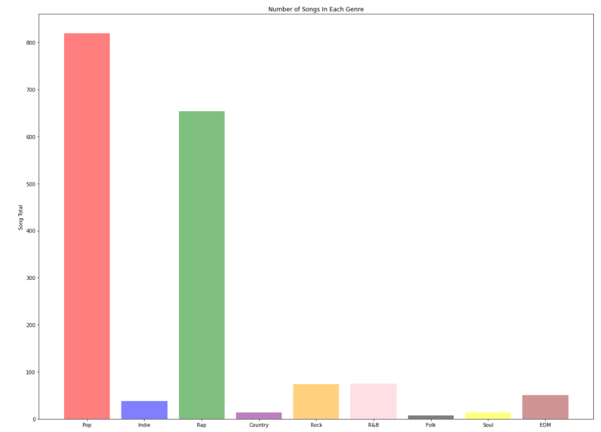

Slide 11
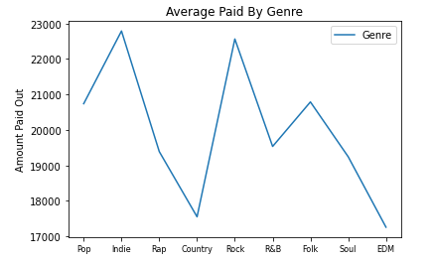
What genres make the most money?
According to SoundCharts and ProducerHive, Spotify pays $0.00318 per stream.
On average, songs that fall in the genres of indie and rock make the most money. While, country and edm songs tend to make less money.

Slide 12
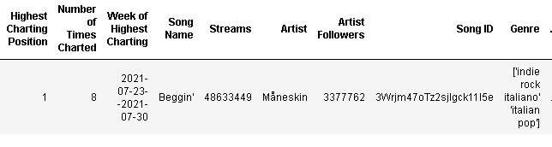
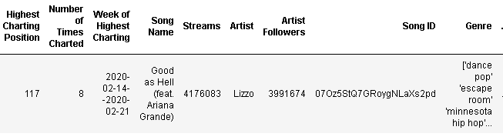
What song made the most money? What made the least?
The amount that was paid out from the highest streaming song 'Beggin' was $154654.37.
The amount that was paid out from the lowest streaming song 'Good as Hell' was $13279.94.

Slide 13
Credits
Spotify Dataset found on Kaggle:
https://www.kaggle.com/sashankpillai/spotify-top-200-charts-20202021
Spotify API Information:
https://developer.spotify.com/discover/

